Slide 1
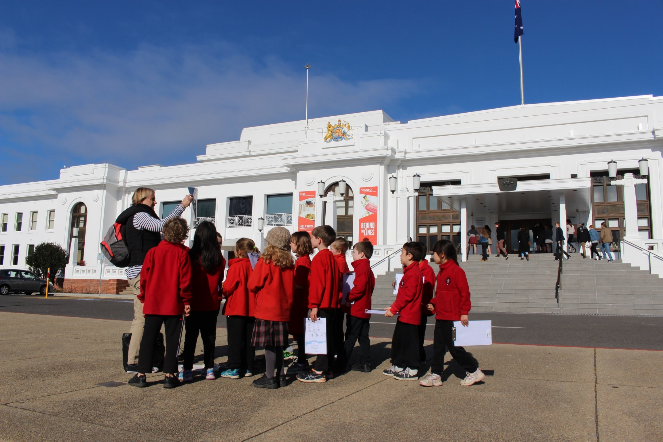
New Directions at Museum of Australian Democracy (MoAD)

Slide 2
Our Learning Vision
Learning is a complex and personal process occurring in many contexts. At its core is the importance of personal experience, transformation, understanding, identity and agency. MoAD embraces the following statement as the bedrock of its learning strategy:
Grow the museum as a leading educational institution providing safe opportunities for deep engagement in the ideas and practices of democracy and civic participation.
We achieve this by providing unique and transformative learning experiences that explore what it means to be an informed and engaged citizen.

Slide 3
A strategy for future learning directions…

Slide 4
1. Improve & refresh existing onsite & online programs

Slide 5
2. Identify new markets for our programs

Slide 6
3. Present outcomes of our work

Slide 7
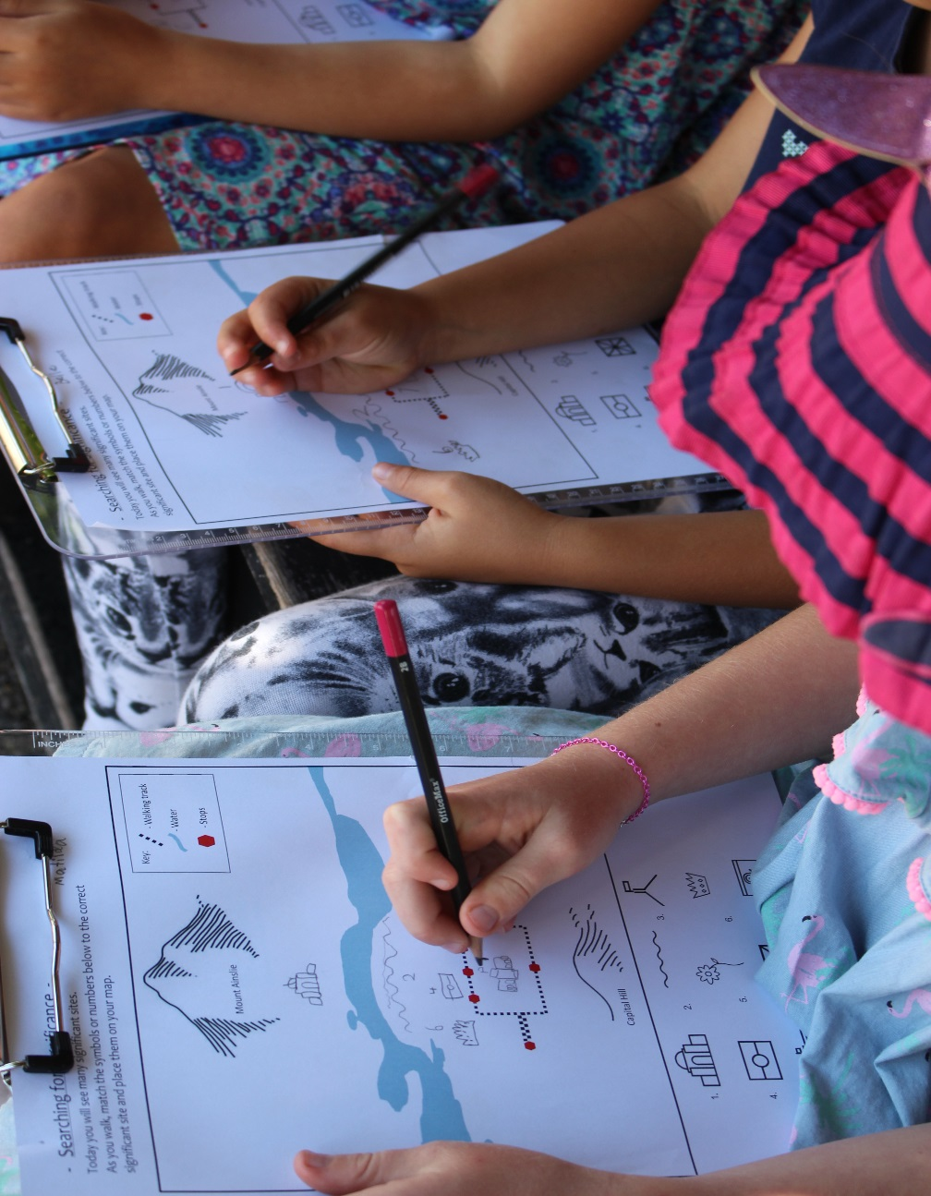
4. Develop new onsite, online and outreach programs

Slide 8
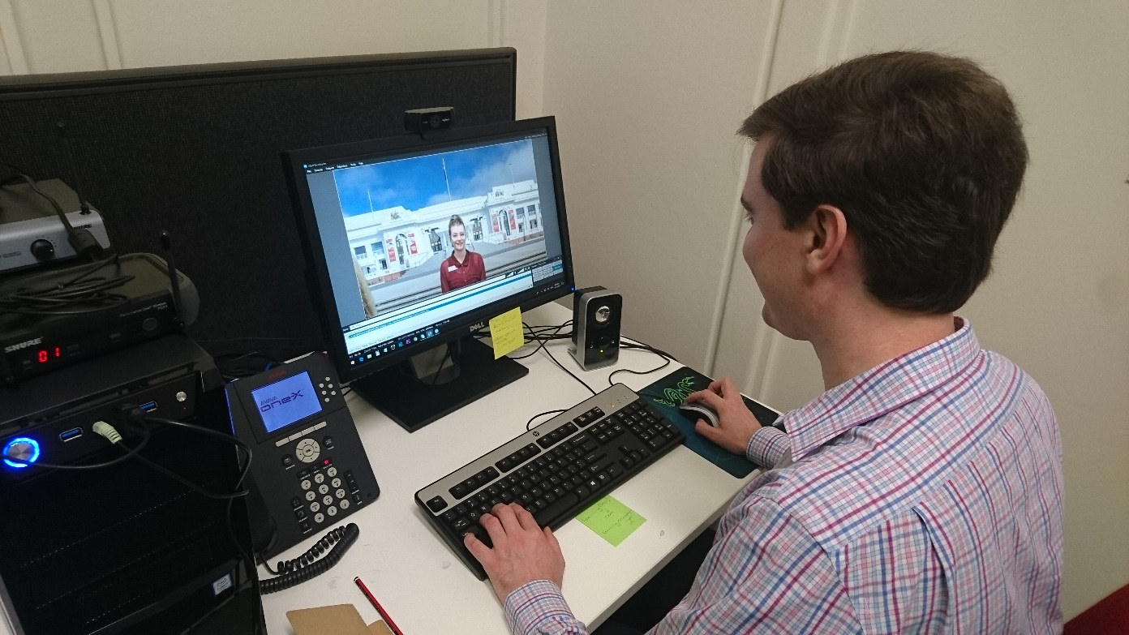
5. Outreach Initiatives -increasing our audience through digital media
Pilot digital outreach studio

Slide 9
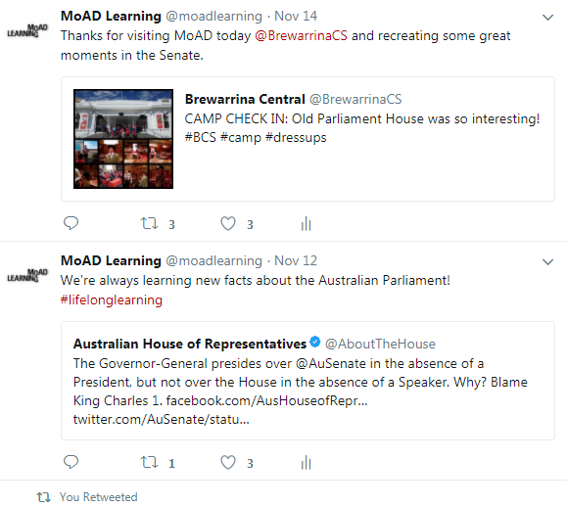
And our social media initiatives…

Slide 10
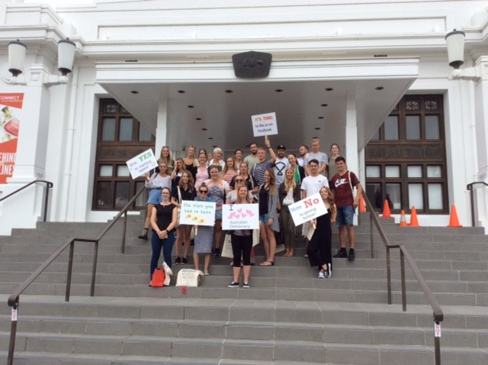
6. Teacher professional development

Slide 11
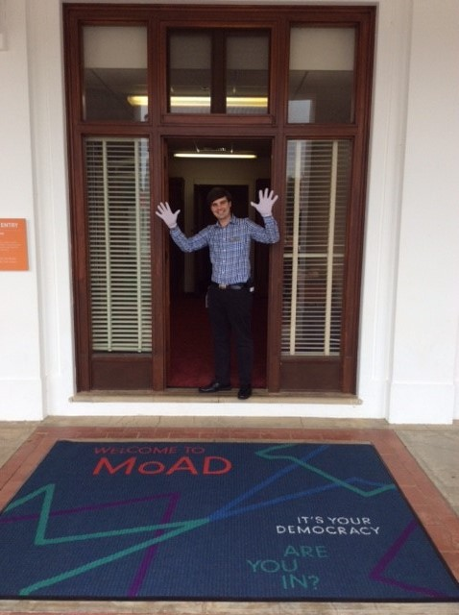
7. The welcome experience

Slide 12
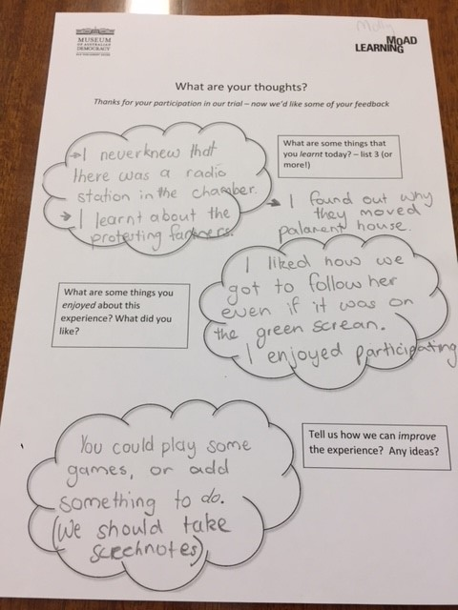
Thank you

