Slide 1
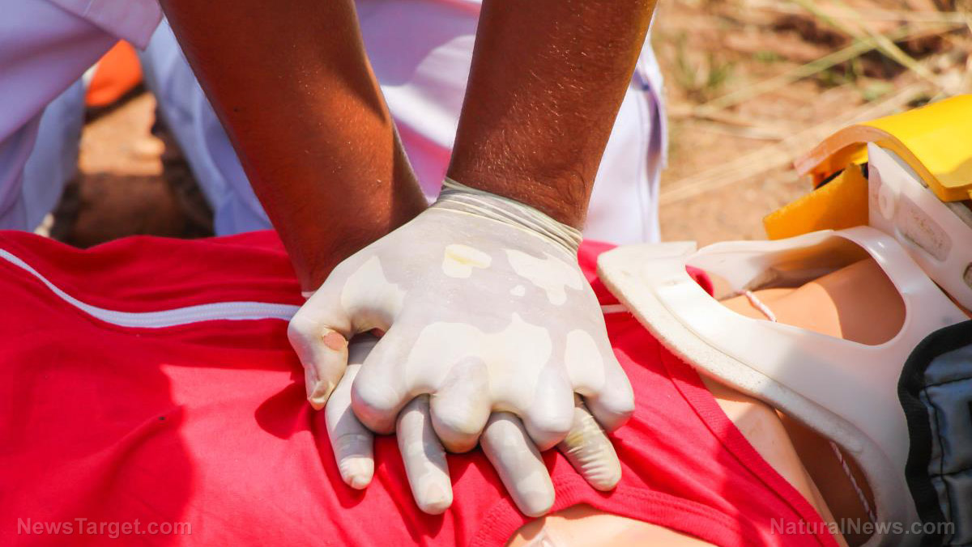
Bringing parliamentary education to life

Slide 2
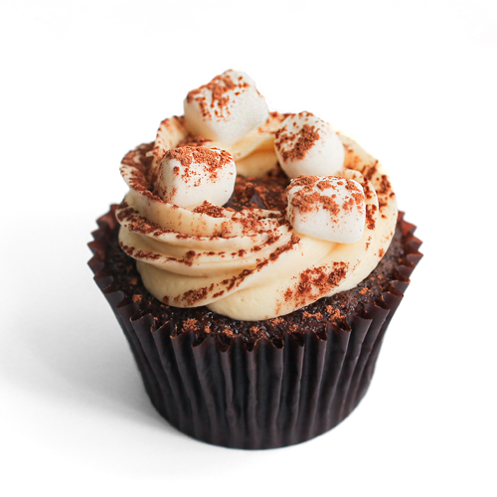
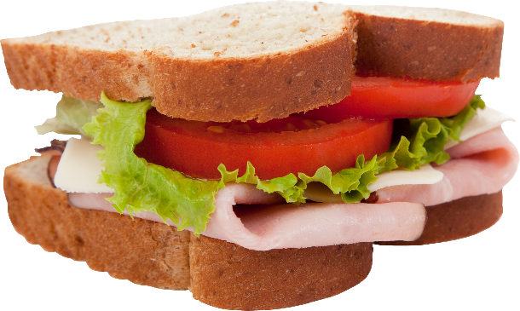
You decide…
Notes:
Choose a volunteer to make some choices for morning tea.
What would you choose
For yourself (why? Something you like, don’t have to think about it. Can make a personal choice – don’t have to be healthy!)
For a friend (Why? You know them, know what they like and don’t like, again, don’t have to make a healthy choice)
For someone you don’t know (me) (Hmmm – a lot of judging going on here!)
For the whole class – everyone has to have the same thing?
How many people would have chosen that for their morning tea? People don’t always want what’s good for them. But what about if you’re funding morning tea from the public purse? How could you find out what people want? Did any of the audience advocate for themselves?
This can be a case of imposing your own like/dislike on the group; making a politically correct or ‘safe’ choice – but even then you can run into problems (diabetics, coeliac disease)…How do you take the needs of minorities into account, while keeping the majority happy?
It’s not always easy to make decisions on behalf of others – but we delegate decision making powers to others in many areas of life. The one we’re talking about today is political representation: we elect Members of Parliament to make decisions on our behalf.
What would you choose for yourself?
What would you choose for your friend?
Why (what you would like, you know your friend, so you know what he/she would like)
What would you choose for someone you don’t know? (Kate or Annemarie)
Why? Get student to justify choice.
What would you choose for the whole class?
Was everyone happy with the choice you made on their behalf? Why or why not?
Is this system fair?
How do we look after groups with special needs?
How do we get what we want – how do we advocate for ourselves?
How does this relate to what we’re doing today?
We delegate decision making to others for practical reasons, but we have to make sure that our processes are robust and fair. And we’re now going to look at one of those key processes…

Slide 3
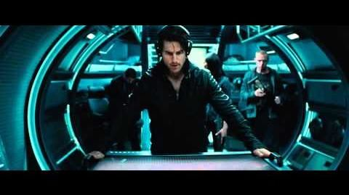
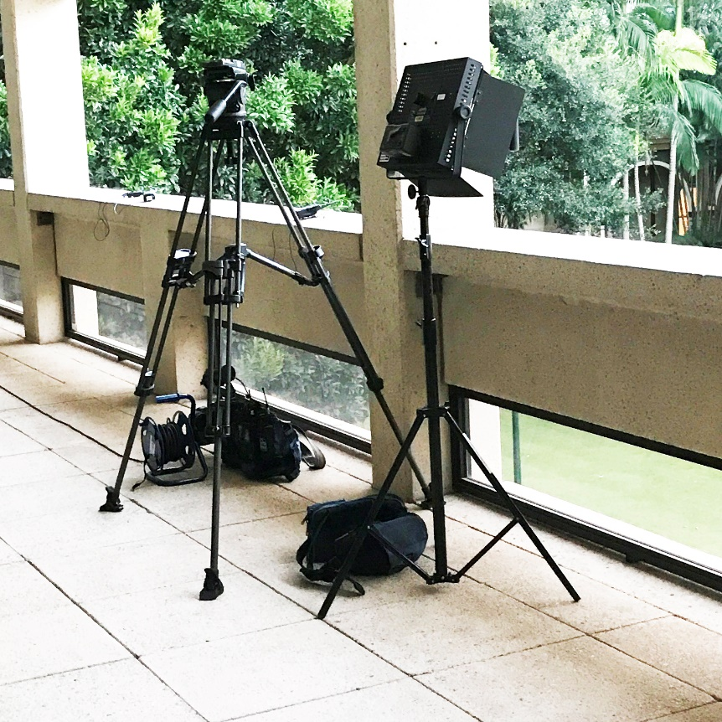
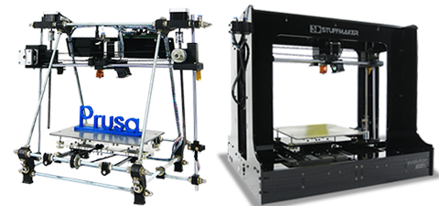
Cutting edge approaches
http://www.3dstuffmakers.com/
https://www.youtube.com/watch?v=oT5cKlOKgwo
http://missionimpossible.wikia.com/wiki/Mission:_Impossible_%E2%80%93_Ghost_Protocol
Notes:
Wouldn’t we all like an Ethan Hunt and all the Mission Impossible gadgetry at our disposal? Imagine what we could do with holograms? Or even a 3 D printer! Actually, we’d settle for some decent video gear – this belongs to one of the commercial TV stations. I was tempted to commandeer it! But no, we don’t have any fabulous technology at our disposal.

Slide 4
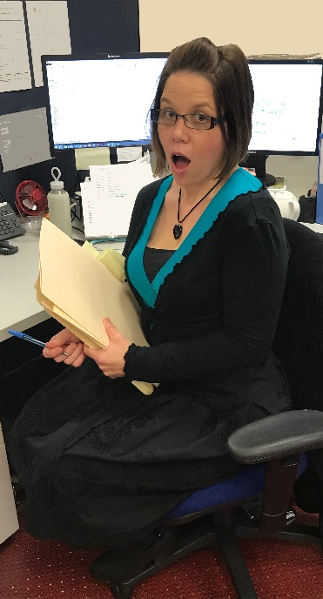
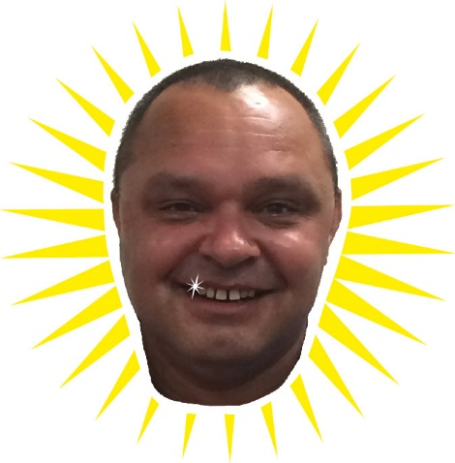
Resources
Notes:
We have our trusty old printer, and a great team! Many of you know Annemarie, our team leader, and we also have Mel, our part-time Support Officer. And Brett, our secret weapon, although we have to loan him out to other areas of the Parliament. And me.

Slide 5
Keeping it real
http://www.northqueenslandregister.com.au/story/4905066/hidden-outback-school-celebrates-50-year-milestone/
Notes:
And the other thing we need to constantly bear in mind is that Queensland is the most decentralised state, with about half of our population living outside the capital city. Many of our audiences don’t have access to much in the way of technology themselves, so we need to create experiences that can be replicated easily – and meaningfully – in the most remote areas.

Slide 6
Knowledge vs learning
https://www.flyingdoctor.org.au/qld/
Notes:
I worked at the Flying Doctor for a couple of years – one of the most decentralised organisations in our country! They know all about service delivery to remote areas. They had a fantastic training program that all new employees had to complete. It was all delivered online with a lot of bells and whistles. Very convenient, you could do it at your own pace, in your own time, on your own laptop. Did that, aced it, got 100%. Got to work, and the General Manager asked, had I completed the course. I said, ‘Sure, and got full marks.’ He said, ‘So, what would you do if an alarm went off right now?’

Slide 7
Wait, what?
http://www.stuff.co.nz
Notes:
I was like, ‘wait what?’ I couldn’t for the life of me remember the evacuation route and where the fire extinguishers were or who I had to report to…And I realised that I could pass a book exam, but I’d burn in the fire.
And I realised, if you want people to learn something, rather than just passing the test, you have to do more. You have to make it matter somehow.

Slide 8
How we learn
The best we can do is dramatize what matters most to learning…
Carey, B., How we learn (2014)
Notes:
We learn best when we (a) physically do something and (b) make an emotional investment and (c) can relate new knowledge to something we already know.

Slide 9
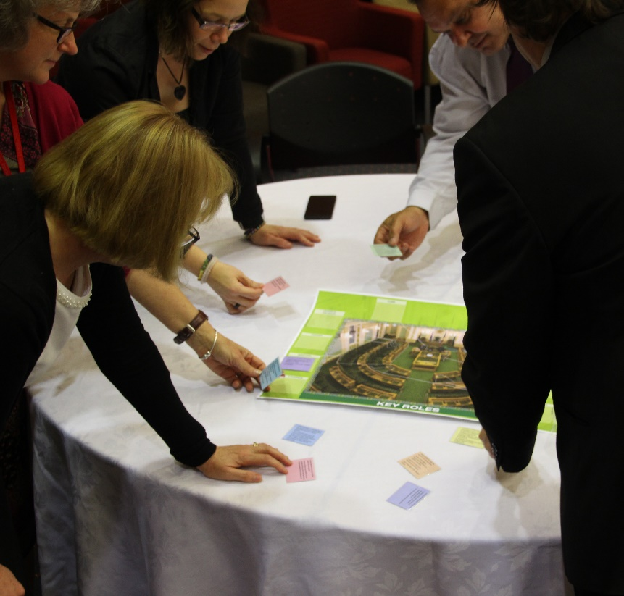
Making it real
doing
&
being
Notes:
And it’s why our students and trainees get more out of our programs when they’re invested, and when they’re learning through doing and being.

Slide 10
Muscle memory
http://www.hiphopjournal.in/health/powermoves-and-muscle-memory
Notes:
And it’s why we do fire drills, of course. The brain stores physical activity. It’s also why we want to get our students and seminar participants out of their chairs and moving around the space. And we can then layer that up with investment. Getting them to make decisions is a good starting point.

Slide 11
Our material can be a little dry
http://www.abc.net.au/news/2015-10-01/australian-deserts-young-but-monsoon-is-old-new-study-shows/6821154

Slide 12
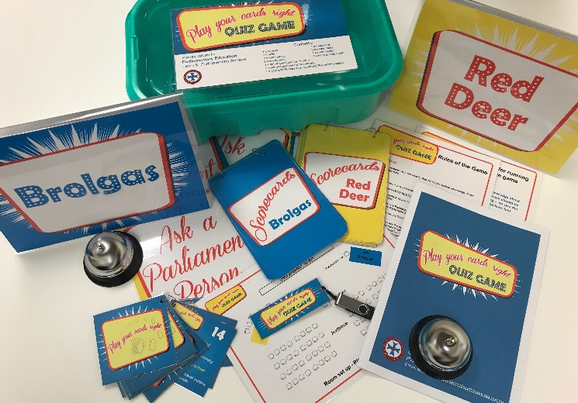
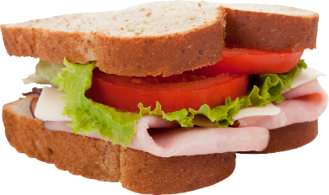
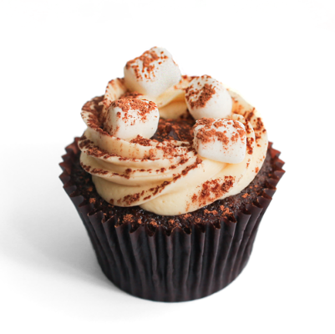
Schools
Notes:
We start a lot of our sessions these days with the morning tea exercise. We also use our game, which my colleague Brett featured at last year’s APEC in Darwin. Again, it’s about moving students around the space and getting them invested, this time through some friendly competition. And it’s fun! It can be hard to find much about Parliament that’s fun, but we know that students learn better when there’s some fun involved. Carey also says that in order to remember, we have to forget first – and sometimes we learn better by being wrong than right. But we have to make sure that being wrong is low risk, so share the responsibility – put the students into teams, give them opportunities to involve the audience. Give them every opportunity to be right – and when they are wrong, make it a learning opportunity.

Slide 13
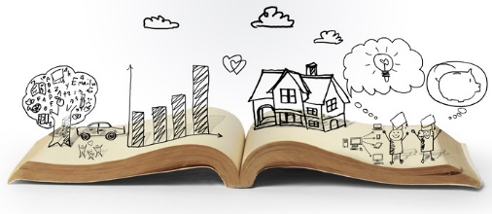
More than a buzz word
http://innovationforsocialchange.org/storytelling-social-change
Notes:
When we’re introducing new material and concepts, we find it helps if we can slot the new information into what the student already knows. The introductory activities are a good way to find out what that is, and to make it explicit for the students themselves – so that they know what they know. Then it’s easier to build on that foundation. And if nothing else, we draw on narrative. It’s a real buzz word these days and for a good reason. We live in a media saturated world, so we really understand stories. We understand character and they challenges and conflicts they face. We understand themes, and we understand setting.
One of the most powerful tools we have is narrative.

Slide 14
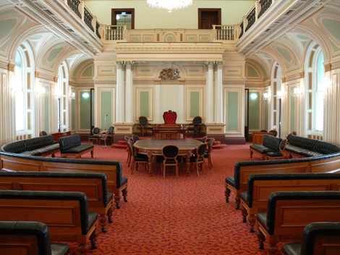
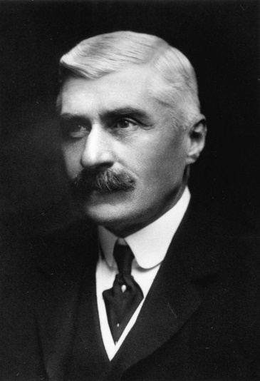
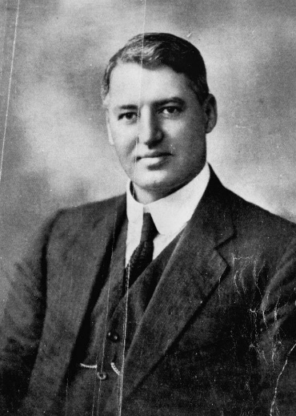
School groups
Notes:
So if we deliver our material using these guidelines, the students are pretty responsive. And if we get them involved in acting out the story, they help to create the action. So they’re more invested, and at the end of the day, they’ll remember more. As the only unicameral state parliament, the story of the abolition of our upper house is one of the key things we look at, because it has ramifications through our history to the way our Parliament works today. We’re lucky because we can use the actual setting. And we enrol the students as actors in the story, and move them around the room, so they get an idea of the way it happened. And when they’re involved in the story, they’re more interested to know ‘how does it end’.

Slide 15
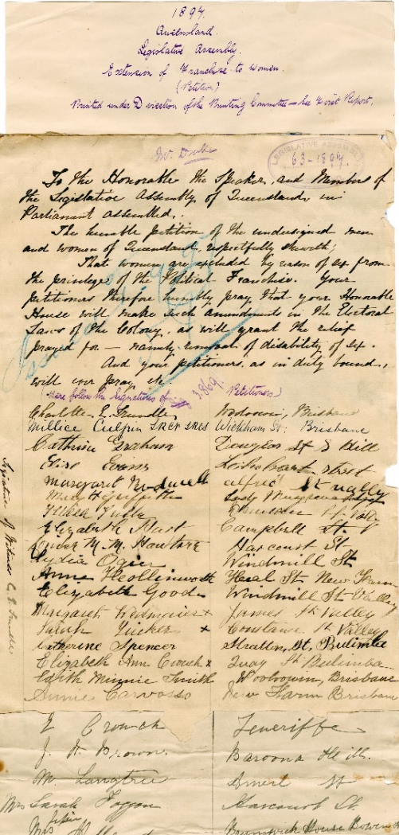
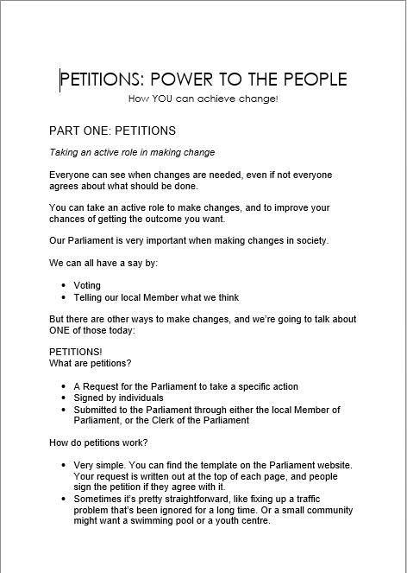
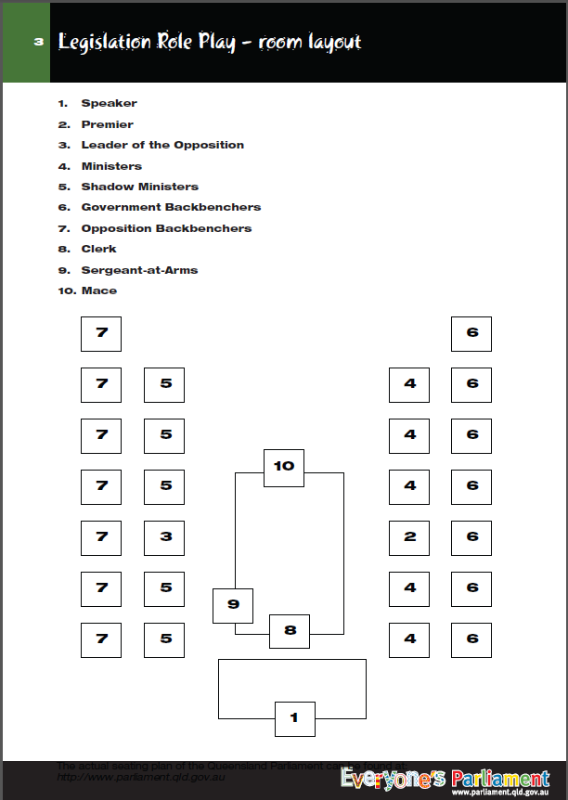
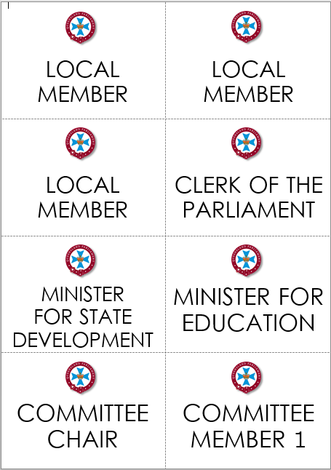
Low risk
Notes:
We all have legislative process role plays – these are great! Teachers love it when we do these role plays because it’s less work for them if we do it. But truly, it doesn’t take much to set up a role play like this, does it? And we know the students get a lot out of it.
We’re also working on a Geoffrey-Robertson-style hypothetical around the separation of powers. This is a pretty abstract concept, even for upper secondary students, so if we can pop them into roles and give them scenarios and get them making and justifying decisions – you get investment. We’ve road tested this one and the feedback so far is that it’s really helpful in making this concept more accessible for the students.
But we’re also looking at a different focus for a lot of our school work. Let’s face it, not many students are going to be passing laws (even though they do need to know how it’s done) or facing separation of powers dilemmas. But most want to see changes in their lives and their communities. And we want them to be directly involved. So we’re looking at petitions and parliamentary committee hearings. Again – with petitions, we start with simple role plays, very low risk for the students, but we get them out of their chairs, moving around the space, and making decisions. What do we need in our community? Will I sign this petition, or not? Who will see my signature? Who will make a decision about this matter? How do I find out what happens with it?

Slide 16
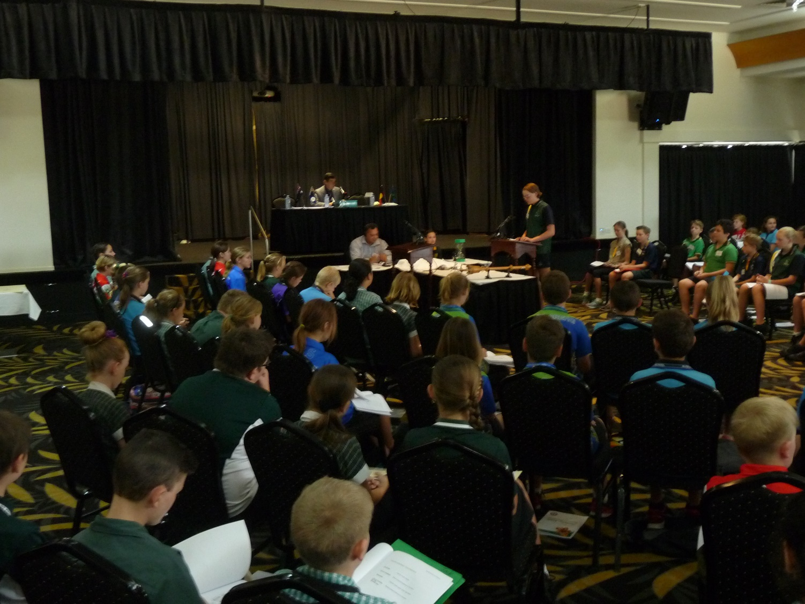
Youth Parliaments…extract from email
The principal mentioned that her school took part in the last Youth Parliament held in Cairns in 2013.
She said at the time that where she was working the students were very disadvantaged and anti-authority.
She said that the experience of participating in the Youth Parliament was extremely valuable for that particular group of students and that they had gained a lot of benefit and understanding from being involved in the process.
Notes:
The ultimate engagement activity is the youth parliament program – I’m sure we can all agree on that! Am I right in assuming that everyone here runs these sorts of events?

Slide 17
Fist pump!
Notes:
Feedback from teachers suggests we’re on the right track. This feedback identifies what we’re aiming for: ‘they can now anchor their studies on Government to something concrete and memorable.

Slide 18
Taking it to the next level
http://blog.learnhotenglish.com
Notes:
But it’s not just students. We want to take our public service training to the next level also.

Slide 19
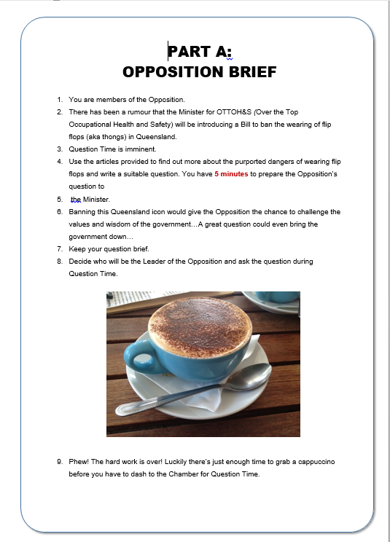
Public Service seminars
FLIP THE FLOPS
Just the ticket…
Get to work, Fabio!
Notes:
Some of you may have seen Annemarie’s presentation on our ‘Flip the Flops’ role play. Role plays seem to have fallen out of favour in adult education, and I’ve seen ‘no role plays!’ as a selling point on more than one training course. But this one is conducted in small groups – which means that everyone has a role and has to invest, but also that they’re not putting it all on the line in front of strangers. It’s safe. But you can feel the energy in the room rise during this activity and it creates its own momentum. Similarly, we’ve introduced a different activity to engage our participants in the budget process (yawn, right?!). We give them a scenario, a problem, and the tools to solve it themselves, and off they go…and it’s self-marking, too. Even better. But then we always have a debrief after all activities, as this is an important space for learning to be cemented.

Slide 20
Afterwards
All this material is great. Thanks for putting it onto USB for us…
…the activities were brilliant and I know I’ll remember that…
Notes:
The proof is in the pudding. What amazes us is the thirst of our participants for this type of learning. The more activities we throw at them, the more they ask for!

Slide 21
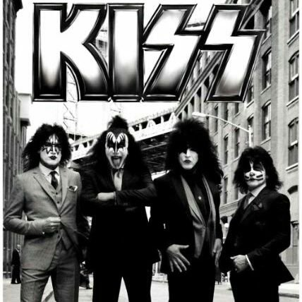
What have we learnt?
https://twitter.com/kissonline
Notes:
What have we learnt. Certainly, keep it simple. A lot of the activities aren’t fully scripted. We have to be flexible in how we manage them – but the destination is the key thing and as long as we know what that is and make it explicit – for example, in the debrief – we don’t mind how we get there. Simple props. Simple room layout.
Keep it story-like.
The other VERY important principle is KEEP IT SAFE. There are a few different strategies here.
Ask for volunteers. Always be positive. Accept all responses, but be prepared to recalibrate or redirect as required.
Scaffold and monitor – Clear instructions. Provide scripts for more complex role plays. Make sure that everyone in the room has a role, to take the pressure off the key players. Check in on group work.
3. Use the space. Get the students up and moving. This can be a bit confronting if you haven’t done it before, but it’s well worthwhile. Have group work at tables, not in front of everyone.

Slide 22
Not convinced yet?
http://onlinelibrary.wiley.com/doi/10.1002/j.1556-6978.1999.tb00574.x/full
http://journals.sagepub.com/doi/abs/10.1177/1052562906294952
https://teaching.unsw.edu.au/assessing-role-play-and-simulation
https://www.blatner.com/adam/pdntbk/rlplayedu.htm
https://www.theguardian.com/teacher-network/teacher-blog/2013/feb/27/play-education-creative-learning-teachers-schools
http://research.avondale.edu.au/cgi/viewcontent.cgi?article=1075&context=edu_papers
http://eprogressiveportfolio.blogspot.com.au/2012/06/normal-0-false-false-false-en-us-x-none.html
http://study.com/academy/lesson/role-play-method-of-teaching-definition-benefits.html
https://www.google.com.au/search?q=value+of+role+play+in+teaching+and+learning&hl=en&ei=gM_mWeCmPMuq0gL4zIXYCA&start=20&sa=N&biw=1248&bih=868
https://serc.carleton.edu/introgeo/roleplaying/reasons.html
http://ro.uow.edu.au/cgi/viewcontent.cgi?article=1091&context=jutlp
http://www.uft.org/teacher-teacher/role-playing-brings-learning-life
http://www.cyc-net.org/cyc-online/cycol-0102-roleplay.html
https://www.teachingenglish.org.uk/article/role-play
http://abourcherif.com/pdfs/Maximizing%20Learning%20Using%20Role%20Playing%20In%20the%20Classroom.pdf
https://otis.coe.uky.edu/ccsso/cssapmodules/sbp/sbp/Role%20PlaySimulation.html
Notes:
There’s plenty of research to support our direction, but we’ve found the validation for the direction we’re taking in the feedback we’ve received, but also the level of engagement in the room. That’s what it’s about for us.

