Slide 1
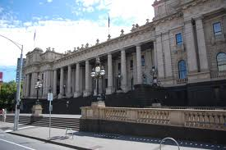
Designing & aligning parliamentary education programs to the curriculum
A Teacher's Perspective
Sandra Venneri
Whitefriars College, Donvale

Slide 2
Advisory Panel
May 2016 – applications were invited to join the Advisory Panel to help shape the Victorian Parliament’s education program and to provide advice on:
The direction and focus of the parliamentary education program, including activities, events and resources
Ongoing development of the program in line with the curriculum and contemporary teaching practices
Opportunities for broadening the reach of the program, particularly to engage with educators and students who do not currently access it
Options to enhance the program through the use of ICT.
A panel of 10 educators currently working in the Victorian education system, whose experience reflected its diversity, was formed.

Slide 3
The starting point – what, how & who?
Current needs of schools:
i.e., identified the growth of VCAL, impact of mandated civics and citizenship curriculum in the middle years, role of professional learning to build teacher confidence, needs of regional areas and adult learners
Platforms for information delivery to schools:
i.e., a mix of digital and print is important, multimedia material needs to be engaging – the content needs to have a look and feel the relates to the audience, re style in which the material is edited and the graphics and language used, interactive and topic based resources are very useful, essential learnings need to be explicit to assist teachers in lesson planning
Engaging with diverse audiences:
i.e., costs for regional students to participate in city-based programs are prohibitive, a multicultural day at Parliament House for EAL students and community outreach to public housing estates were suggested, development of a parliament app was recommended as was on-site professional learning for teachers with a hands-on practical emphasis, devolvement of effective communication networks/ channels and a creative marketing approach should be a priority to ensure a wider reach for the existing – and new - parliamentary education programs and resources.

Slide 4
The next step – A Teacher Survey:
Creation of an online teacher survey to inform the Panel of what is currently in use in the community, what teachers value and want .
Early March 2017 the survey was distributed via a link within the Springboard newsletter and promoted on the Parliament of Victoria website and Facebook page.
In the meantime …
Proposed projects for 2017:
Year 8-10 resources to reflect the Victorian Curriculum
Newly accredited VCE Legal Studies to be implemented in 2018 – emphasis on the work of Committees and Royal Commissions
Adult education resources

Slide 5
Teacher Survey – what did we learn?
Responses to the question on levels of confidence in teaching civics and citizenship suggested that there is a need for more professional learning in this area.
The high percentage of respondents who had not accessed parliament’s programs suggested that there is a market to tap in to and service; completing the survey is a start!
Needs of metro and regional teachers differ significantly; traditional print resources are still needed

Slide 6
Further suggestions?
Series of lesson plans be developed that would include hyperlinks to tours and program information, and references to the Victorian Curriculum on the VCAA website
Proposed topics: the role of parliamentary committees, the suffragette movement and petitions as way of engaging with parliament
A digital resource module prototype on the 8 Hour Day was proposed and a contractor since engaged and is progressing.
The intention is to develop a series of modules supported by lesson plans that focus on historical events in Victoria's history.

Slide 8
Learning Goals
Resources & Materials
Activities

Slide 9
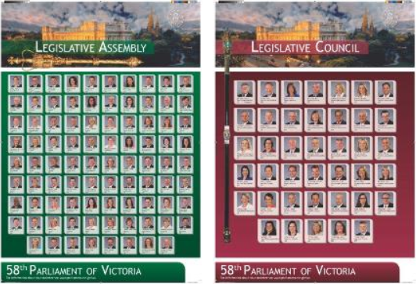
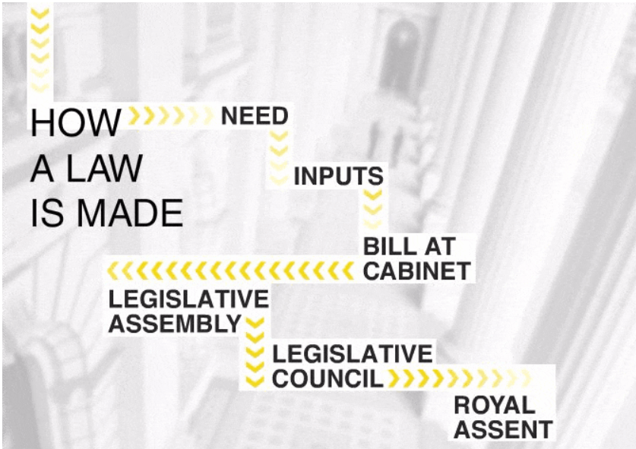
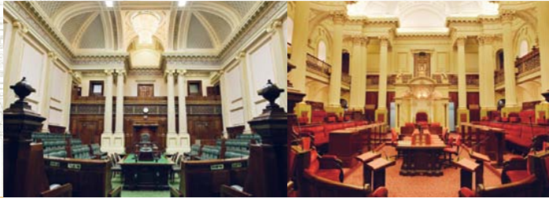

Slide 10
Professional learning for teachers
Value of presenting at conferences employing a hands-on approach
Focussing on specific topics such as “how to teach about committees”
Accessibility of webinars
Downloadable PDFs to support face-to-face professional learning
Provision of professional development for pre-service teachers

