Slide 1

Session 9
The Emergence of the Modern Learner: From Me to We
Dr Sofia Pardo
IdeasLab

Slide 2
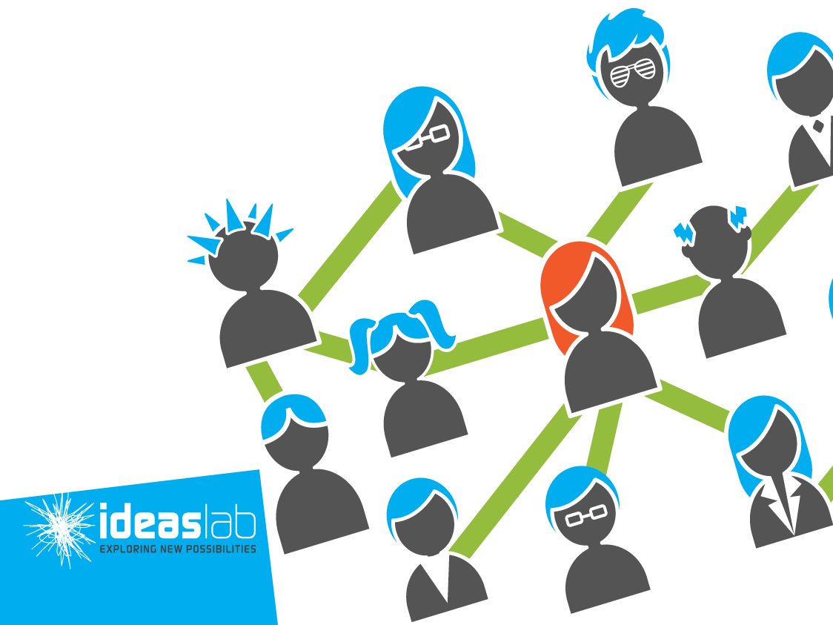
The emergence of the Modern Learner, from Me to We?
Sofia Pardo PhD
Notes:
Exploring Contemporary Pedagogies for Teaching and Learning … in a technology-rich world
How well are we responding to both the needs of our modern learners, and the unprecedented possibilities technology is now presenting them with? Is it time for us to be much bolder and more ambitious in our expectations of what our modern learners might be capable of? If so, what could and should school look like, or is it time for us to more radically rethink the nature and purpose of schooling?
In this one-day workshop, world-renowned pedagogical consultant Bruce Dixon will challenge many of the assumptions we have made about the way in which we use technology in our schools; it will explore our ideas of integration vs. disruption, and it will seek to build a case for more ambitious and bolder thinking about the steps we might take in the future.
This event will appeal to forward-thinking Superintendents, Directors of Education, Deans of Faculties of Education, as well as Directors of Learning & Educational Technology, Curriculum Developers, and Instructional Designers. The day will progress through the following three sections:
Part 1: Are you ready for this? Re-scoping vision in a technology-rich world
Part 2: Understanding the Modern Learner: the realities of their world, and the implications for teaching and learning.
Part 3: Turning vision into reality: challenges and opportunities in leading the change to a technology-rich learning environment.
Each section will include critical conversations, time for reflection, and case study group work to explore some of the key ideas and questions that must be addressed for leaders looking to better understand the role of technology within their schools
Connecting
Rethinking Quality
Rethinking Access
Communicating
Rethinking Transparency
Rethinking Publishing
Collaborating
Rethinking Control
Rethinking Participation
Learning Collectively
Rethinking Ownership
Rethinking Openness
Thinking we’d use network diagrams (the different ones for the different sections) for the page theme/background – much jazzy than what I have whipped up
Probably going too far but instead of the title Virtual Pedagogies for Transformation could we use “Virtual Pedagogies for Rethinking Transformation”
Instead of immersion....
Rethink Participation
Its not enough to connect to a network and respond to ideas, we need to be involved in
From Henry Jenkins:
“Participatory Culture
For the moment, let's define participatory culture as one:
1. With relatively low barriers to artistic expression and civic engagement
2. With strong support for creating and sharing one's creations with others
3. With some type of informal mentorship whereby what is known by the most experienced is passed along to novices
4. Where members believe that their contributions matter
5. Where members feel some degree of social connection with one another (at the least they care what other people think about what they have created).
Not every member must contribute, but all must believe they are free to contribute when ready and that what they contribute will be appropriately valued.
“
So the list would be:
PS> Great quote, would you recommend the book?
On 24/05/11 9:07 PM, "Bruce Dixon" <bdixon@aalf.org> wrote:
The new culture of learning actually comprises two elements. The first is a massive information network that provides almost unlimited access and resources to learn about anything. The second is a bounded and structured environment that allows for unlimited agency to build and experiment with things within those boundaries. The reason we have failed to embrace these notions is that neither one alone makes for effective learning. It is the combination of the two, and the interplay between them, that makes the new culture of learning so powerful.
Seeley Brown, John. Thomas, Douglas (2011). A New Culture of Learning: Cultivating the Imagination for a World of Constant Change (p. 5). CreateSpace. Kindle Edition.

Slide 3
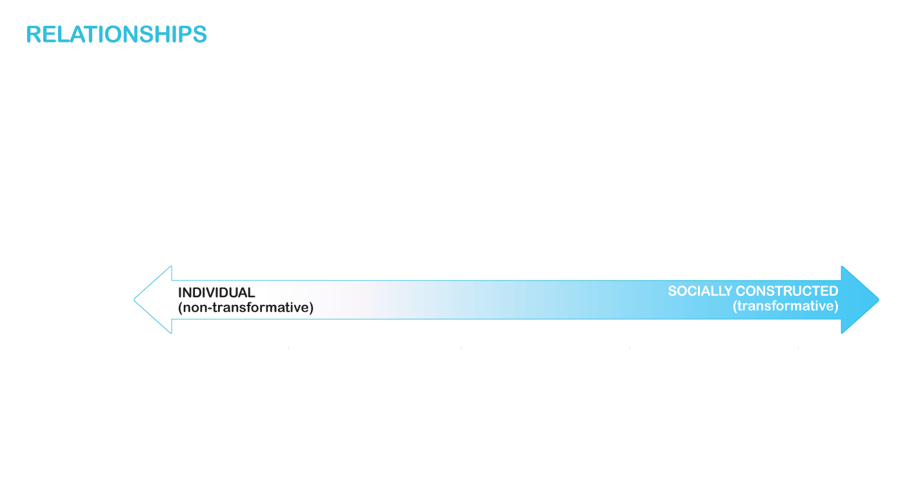
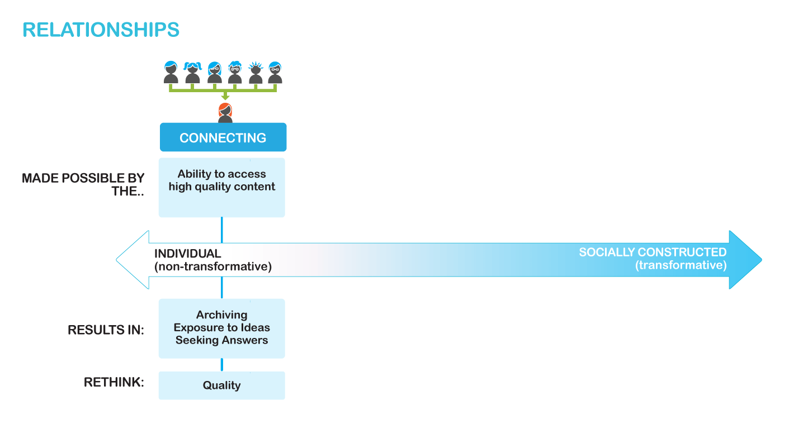
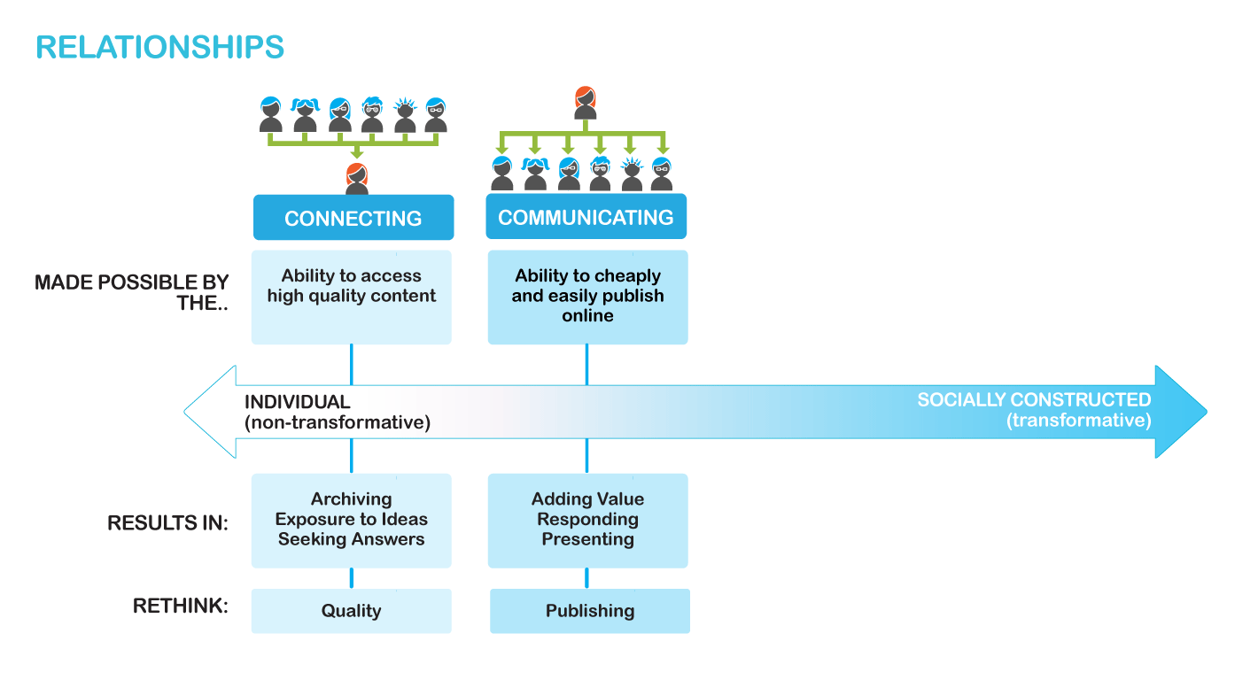
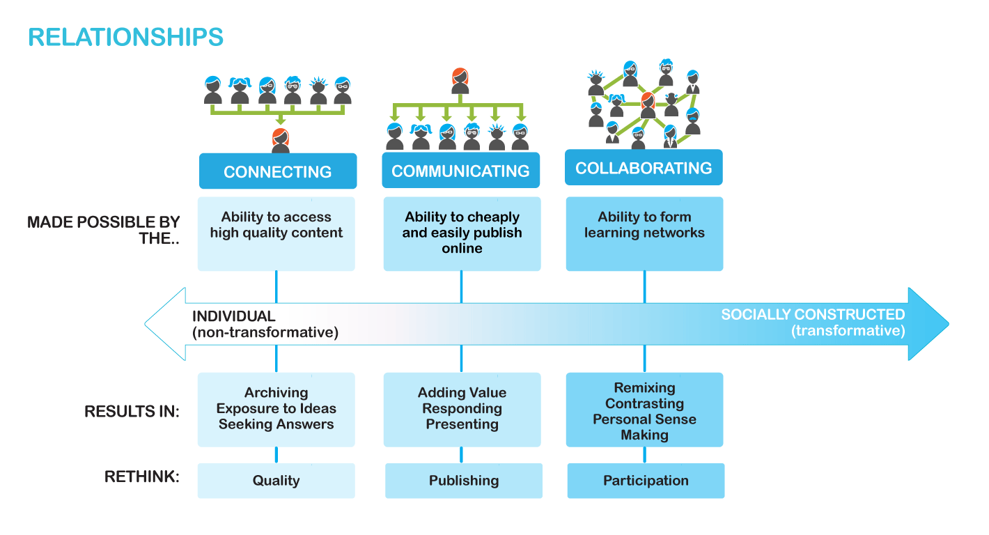
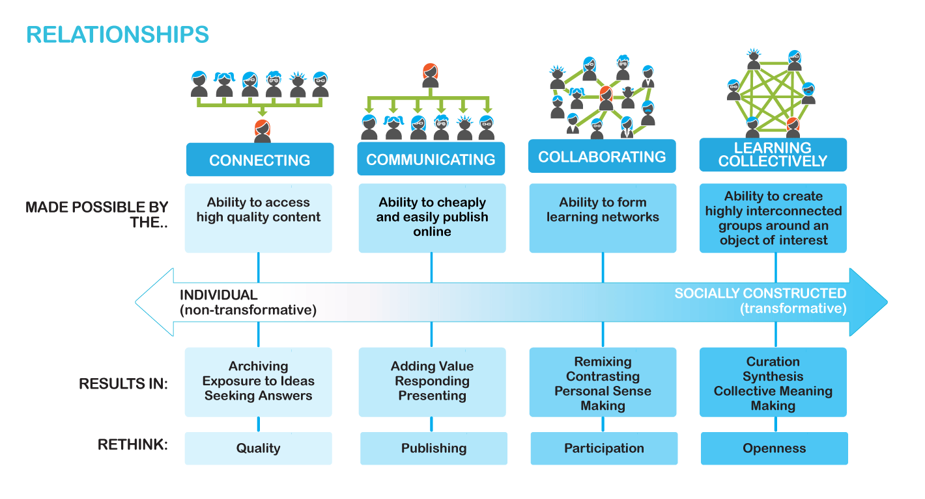
Notes:
Modern technology changes our thinking around the way we construct knowledge from the individual to the collective
How does ubiquitous access to modern technology change the nature of relationships and the way we construct knowledge?
For the modern learner, learning isn’t individual; it is a shared social experience. It is not what our students know, but what they all know together.
For the modern learner, learning isn’t about the recall of facts, for these are only a search away. Rather modern learning is about solving real problems and addressing our students’ individual needs.
Finally, the modern learner doesn’t rely on a single expert or single opinion, our students use modern technology and the Internet to draw on many different influences.

Slide 4
Notes:
How does ubiquitous access to modern technology change our thinking around relationships and the way we construct knowledge?

Slide 5
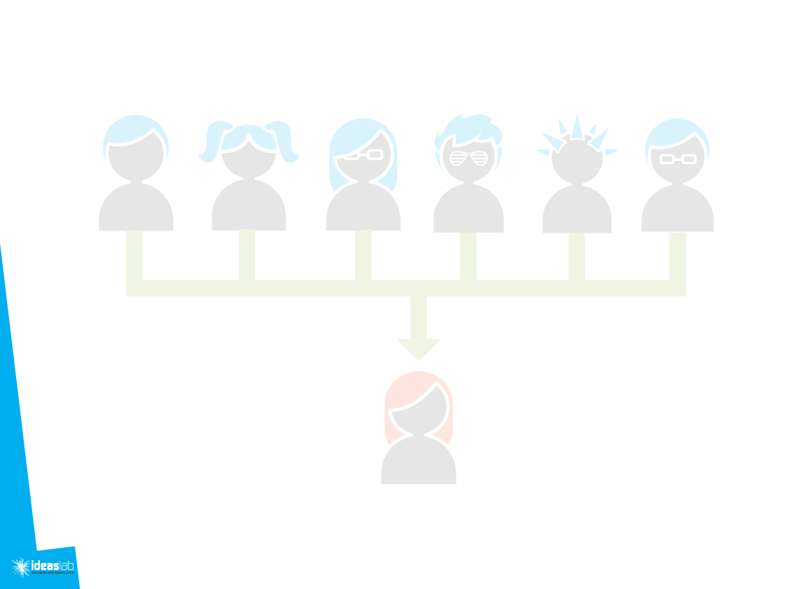
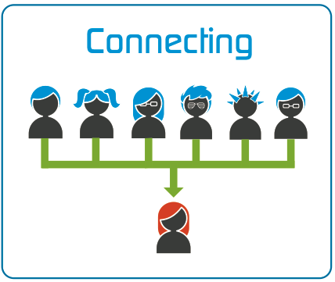
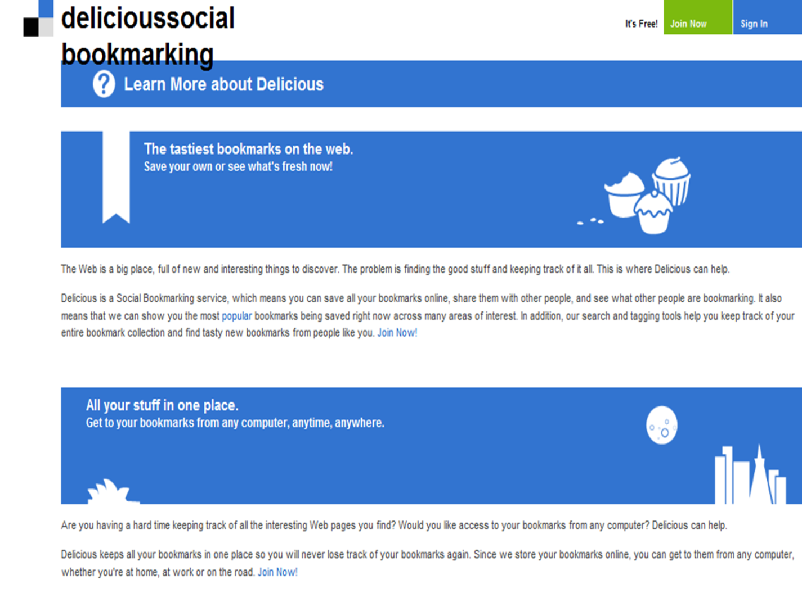
Activities
How does the availability of diverse, high quality and easily accessible content change the way our students learn?
Archiving
Exposure to Ideas
Seeking Answers
https://delicious.com/
Notes:
Accessing Q and A forums, learning how to ask questions, search for answers

Slide 6
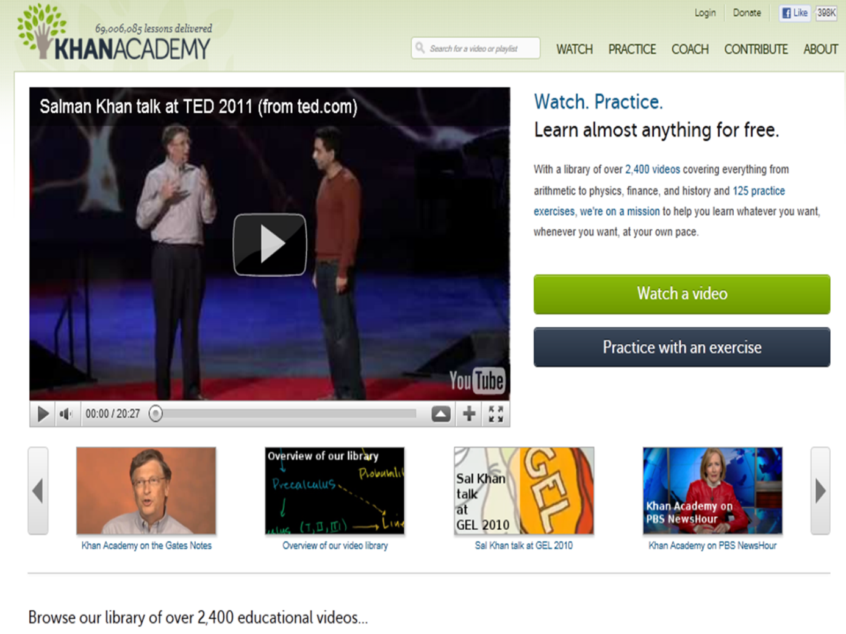
Pedagogies
What opportunities are presented to schools when leveraging content on the Internet?
Flipped Learning
Learning Objects
Smart Software
https://www.khanacademy.org/
Notes:
Virtual pedagogies that use technology as complimentary to the offline curriculum

Slide 7
Critical Reflections:
Is it the teacher’s role to quality assure online content?
Schools (and others) who try to compete with the Internet on creating quality content are destined to fail.
Critical consumption is a key competency of the 21st century learner.
Rethink Quality
Rethink Access
Notes:
Critical consumption – how do students access what is correct?
Being able to retrieve information is becoming the same as knowing it
Access – mobile devices

Slide 9
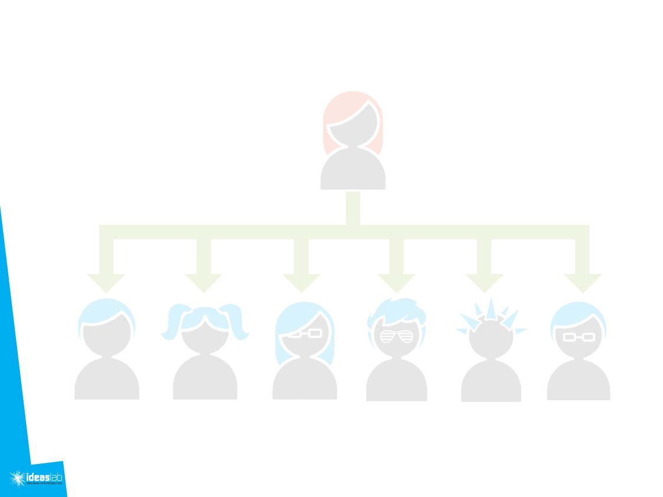
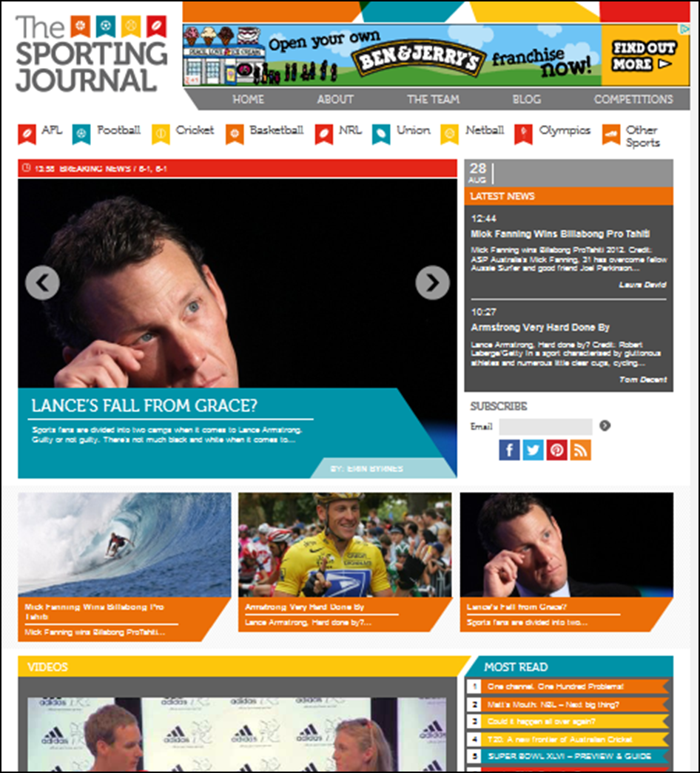
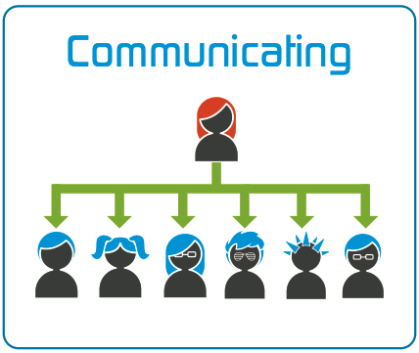
Activities
How does easy online publishing change the way that our students learn?
Adding Value
Responding
Presenting
http://www.sportingjournal.com.au/
Notes:
The Sporting Journal was founded in June 2011, starting as a Sports Blog, but since then has grown into a sports news and opinion website and a growing online media organisation. Currently all their reporters are currently aged between 13 – 25 and are all very keen to learn and grow their skills. Their founder, Jacob Arnott is 14 years old and completing 8th Grade

Slide 10
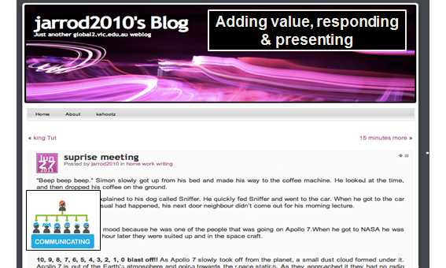
Pedagogies
What opportunities are presented to schools when students publish online?
Digital Portfolios
Reflective Practice
http://global2.vic.edu.au/

Slide 11
Critical Reflections:
Communicate the whole learning process not just student achievements.
It is not simply about finding an audience, it is about joining a conversation.
Transparency causes the students to become teachers.
Rethink
Publishing
Rethink Transparency
Notes:
What opportunities does networked communication provide for students and schools?
How do we find balance between privacy and identity?

Slide 13
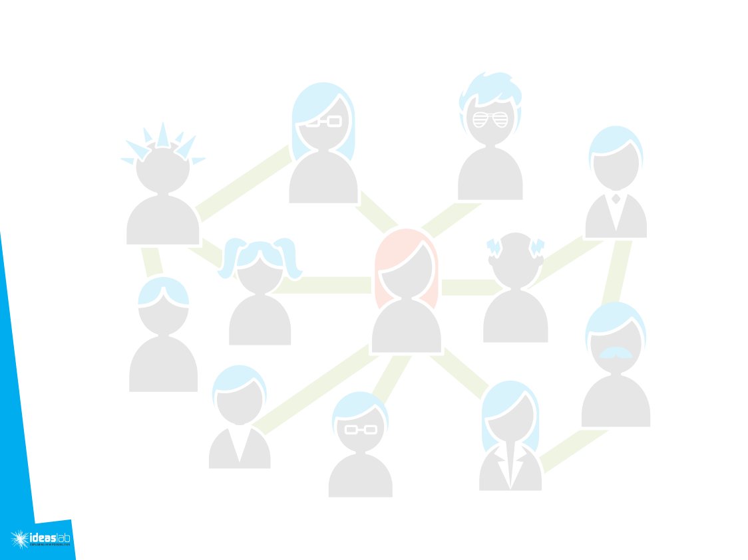
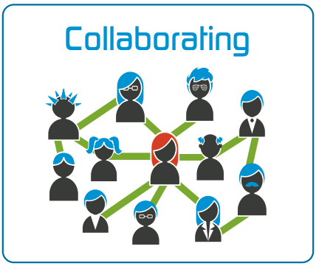
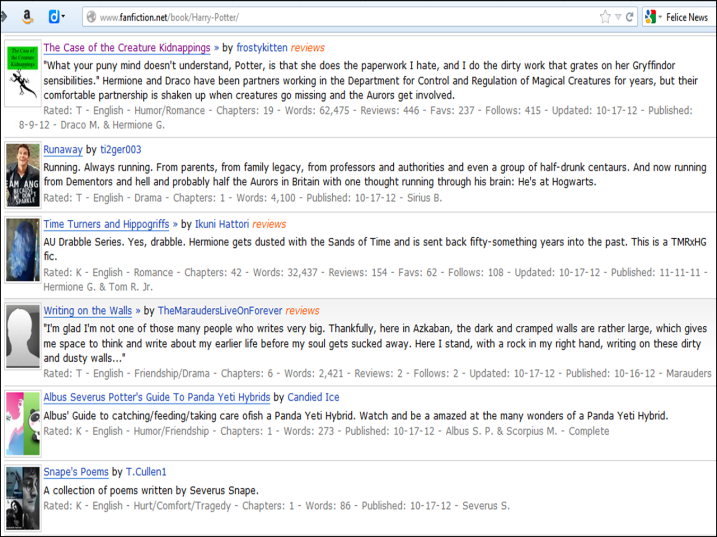

How does the ability to create networks change the way that our students learn?
Activities:
Remixing
Contrasting
Personal Sense Making

Slide 14
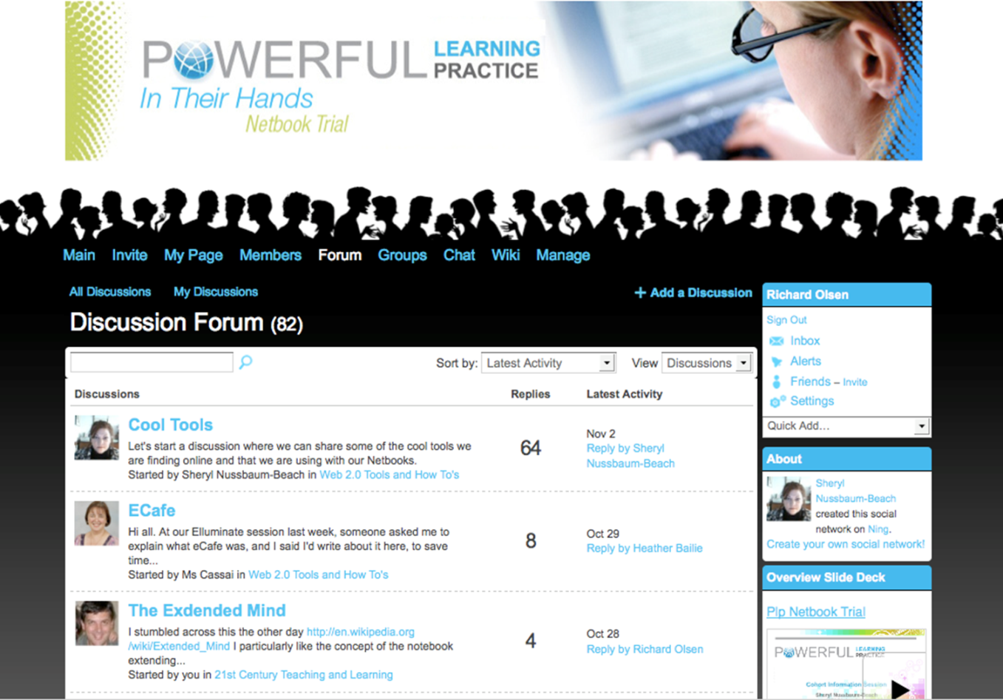
Pedagogies
What opportunities are presented to schools when our students create learning networks?
Personal Learning Networks
Situated Learning
http://www.ning.com/

Slide 15
Critical Reflections…
Schools cannot compete with learning networks on currency.
Participation in networks produces exponential benefits.
Participation in networks changes the student role.
Rethink Control
Rethink Participation

Slide 16
.

Slide 17
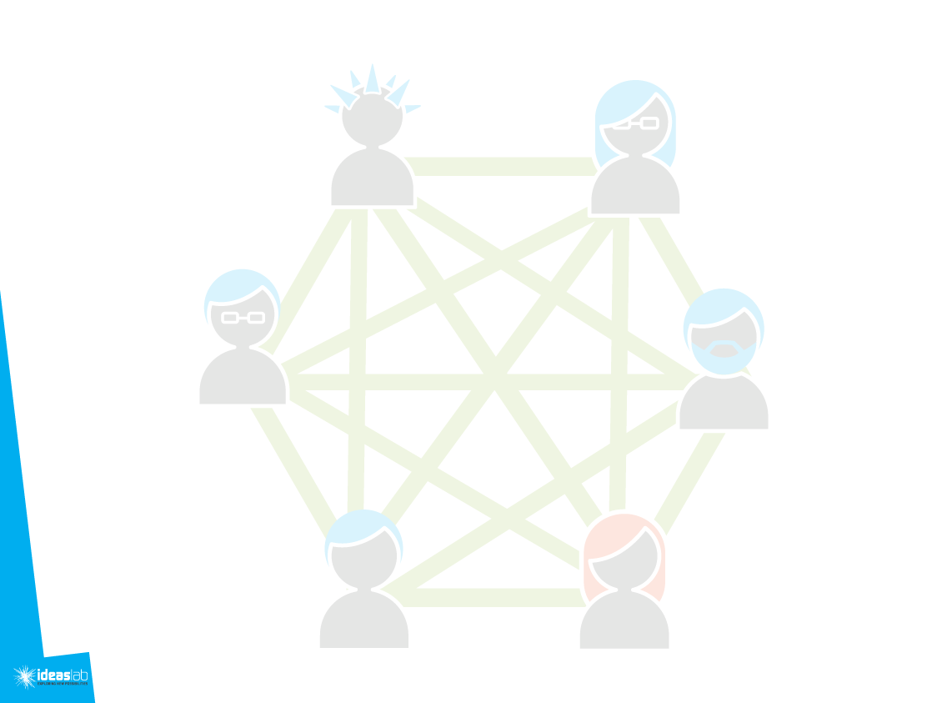
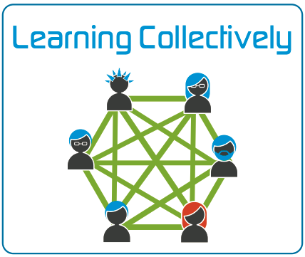
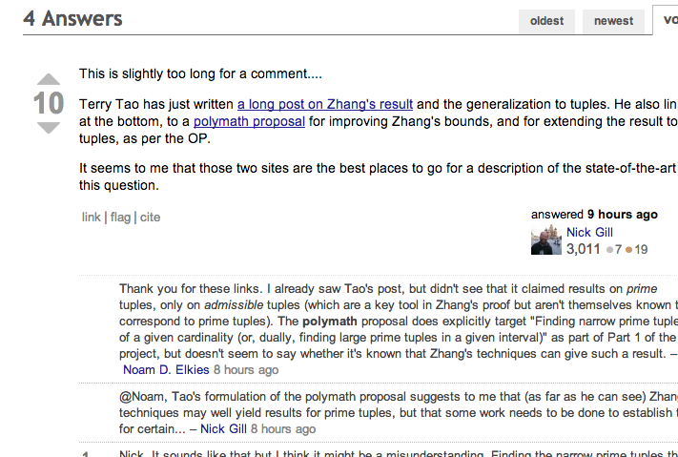
How does the ability to form groups around interests change the way that our students learn?
Activities
Curation
Synthesis
Collective Meaning Making
http://mathoverflow.net/

Slide 18
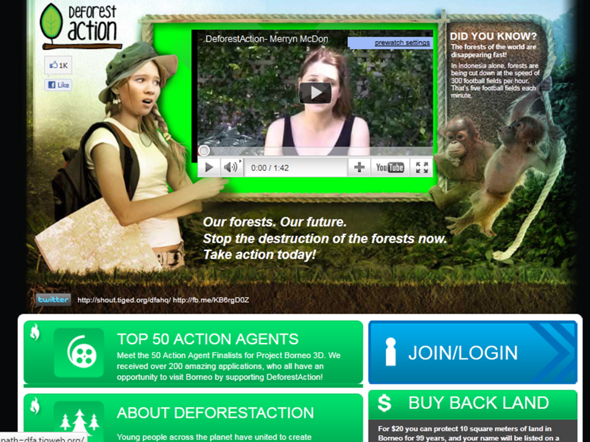
What opportunities are presented to schools when students form groups around interests and passions?
Pedagogies
Social Learning
Object centred sociality
https://dfa.tigweb.org/

Slide 19
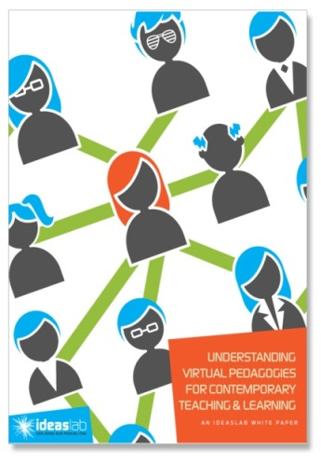
Critical Reflections…
Knowledge is no longer based on authority but on connections.
Transparency improves quality and relevance.
Are interconnectedness and autonomy dissonant?
Rethink Openness
Rethink Ownership

Slide 21
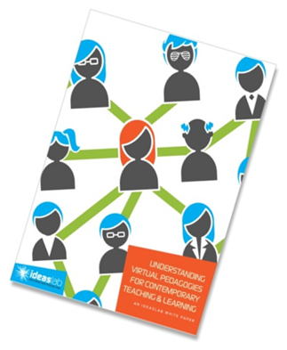
http://www.ideaslab.edu.au/
sofia@ideaslab.edu.au
Pardo.sofia.m@edumail.vic.gov.au

Slide 22
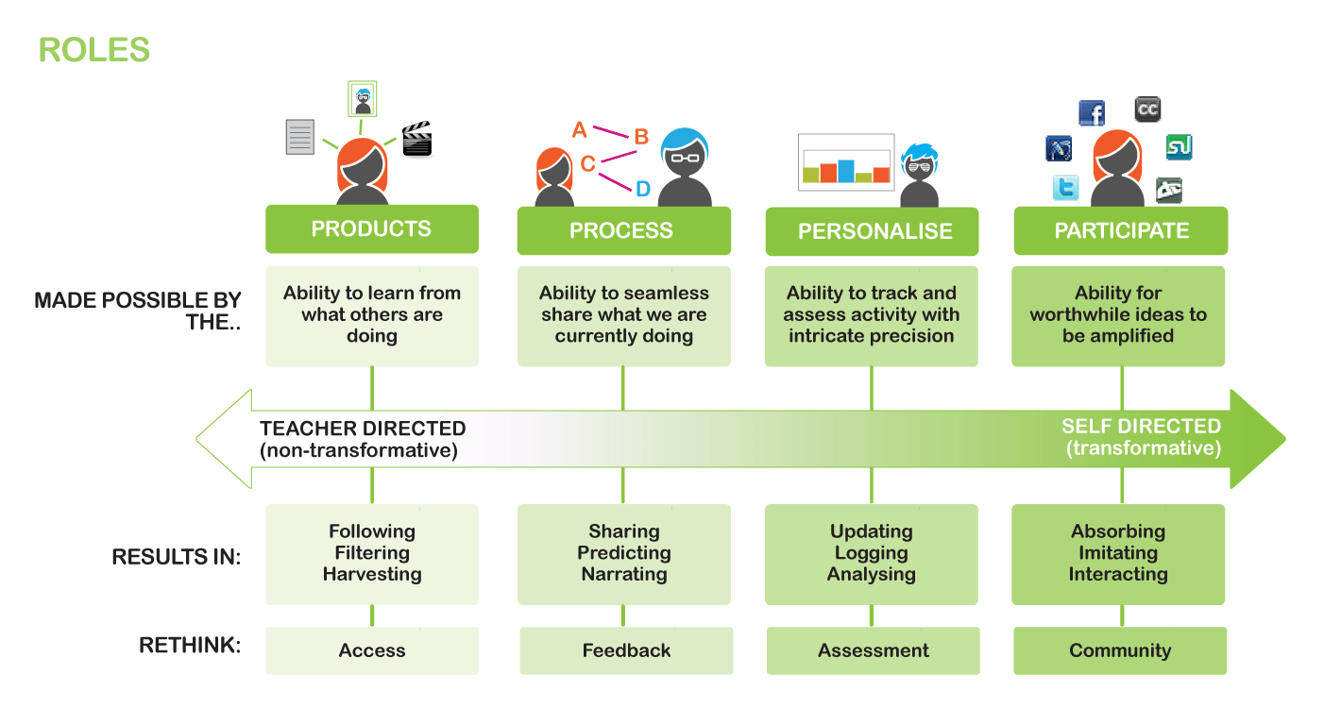
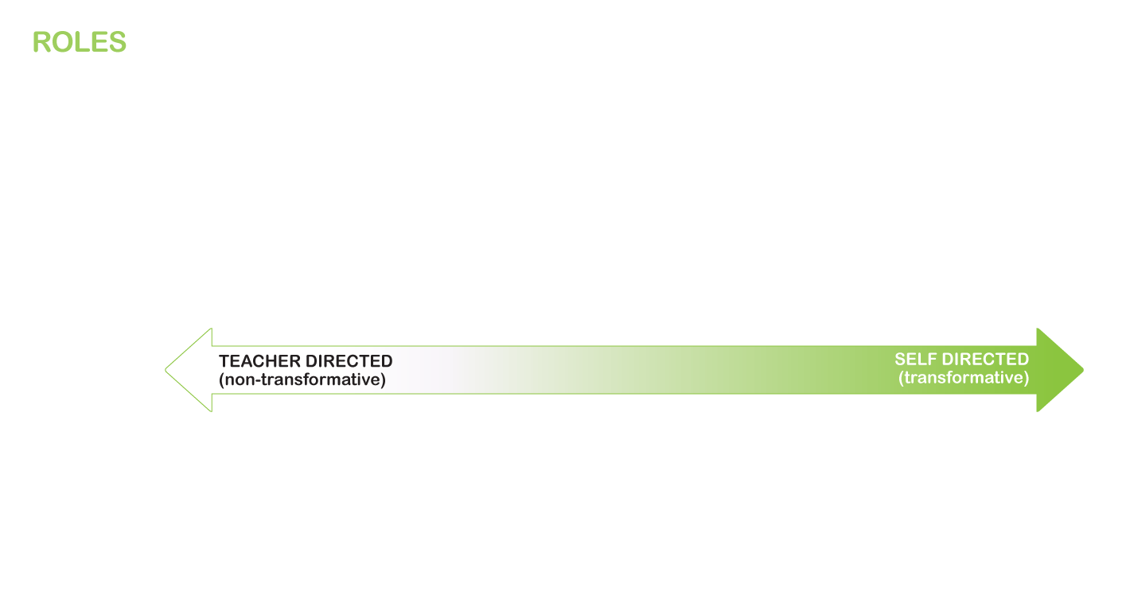
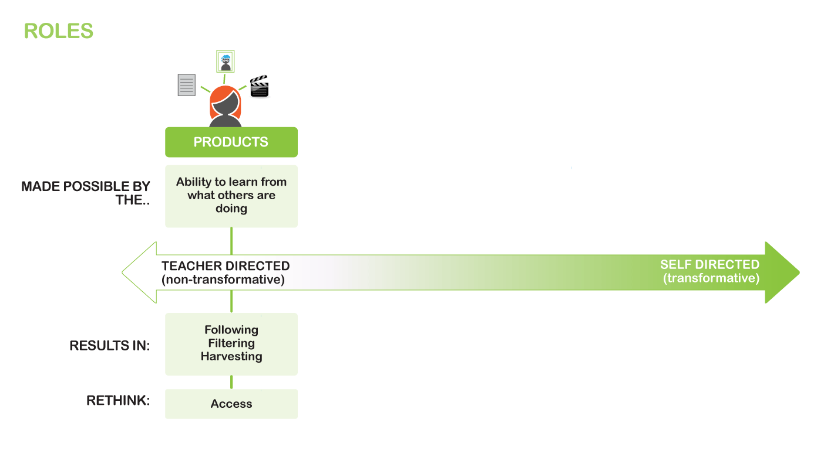
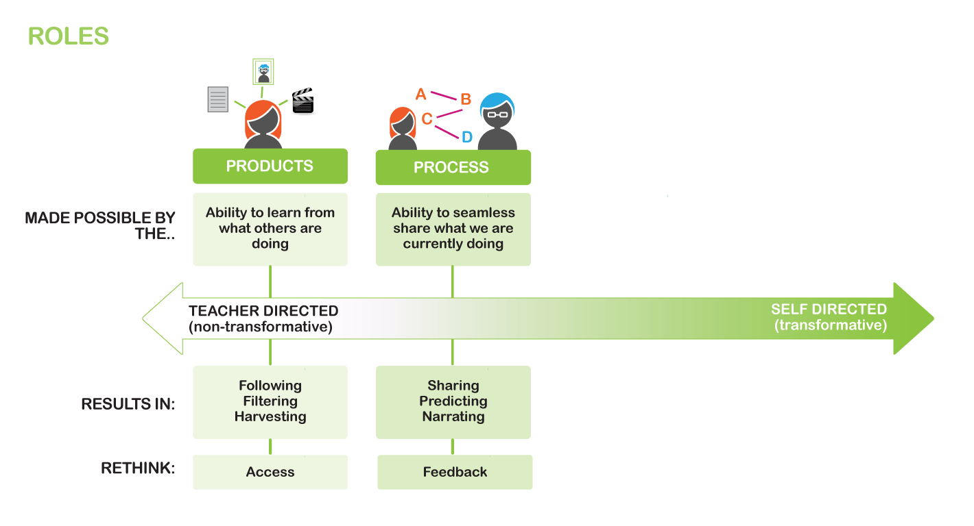
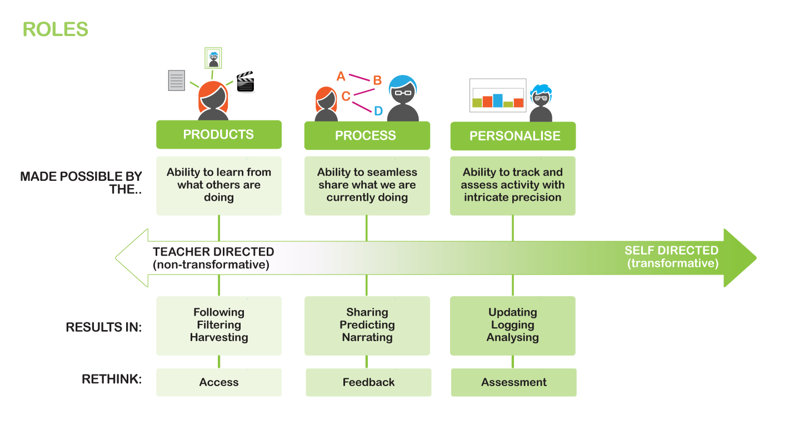

Slide 23
