Slide 1
PRESENTATION ON Parliamentary outrigger workshop (POW)
National Parliament of Solomon islands , Honiara, Solomon Islands
Parliamentary Civic Education Department (PCED)
Present by Marisa Pepa & Alex Seama

Slide 2
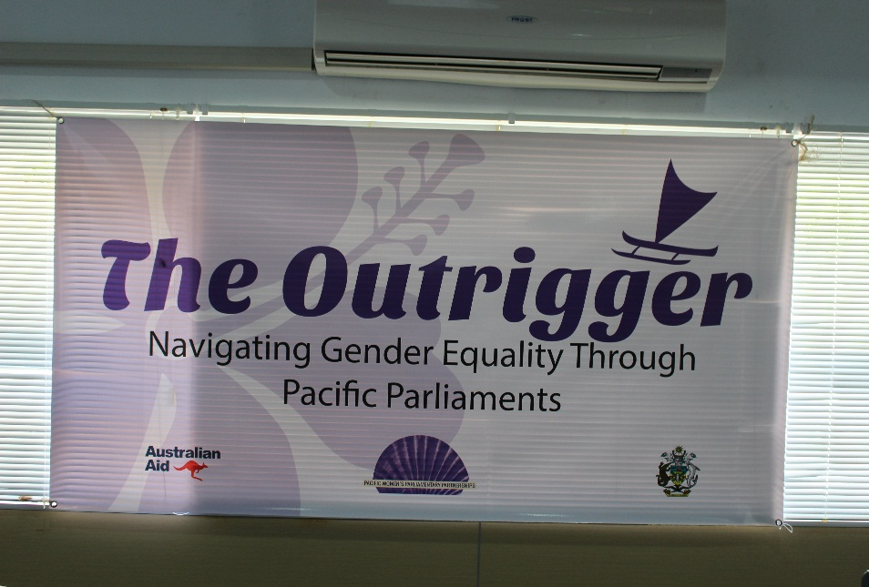
Outline of presentation
Purpose/Objective
Program
closing program
Facilitators/participants
Funding
Recommendations.

Slide 3
Objectives
Explain, the real meaning of gender equality in its modern context.
Discuss general features of gender equality and its relationship to Parliament & Politics.
Identify the challenges & problems faced by countries in the Pacific in translating gender equality in the work of Parliament, government policies and governance structures.

Slide 4
Objectives
Identify better ways or interests of men and women that need to be considered by Parliament and translate into national legislatures and policies.
Collectively ensure gender equality is a national priority for successive governments in the Pacific including Solomon Islands in the future.

Slide 5
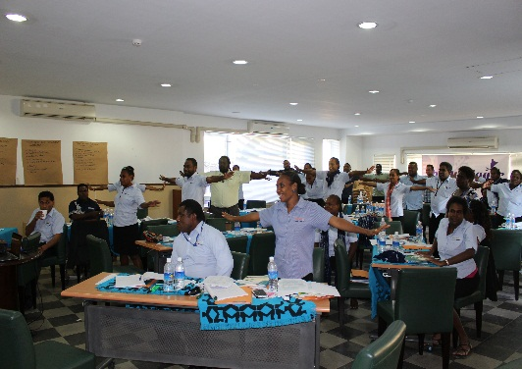
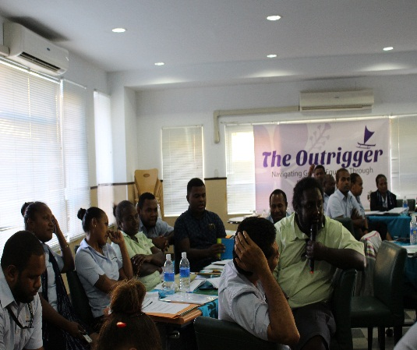
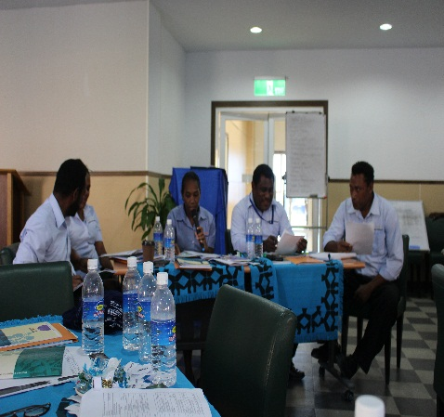
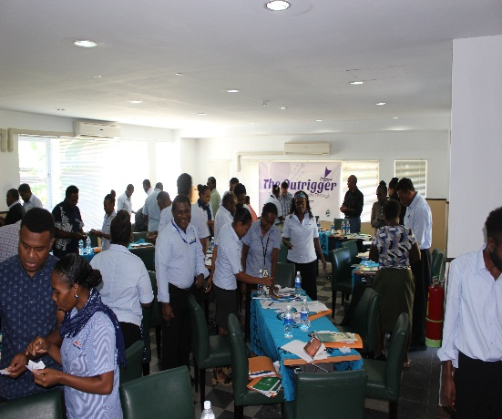
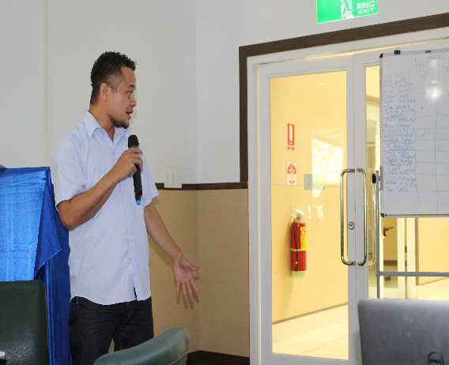
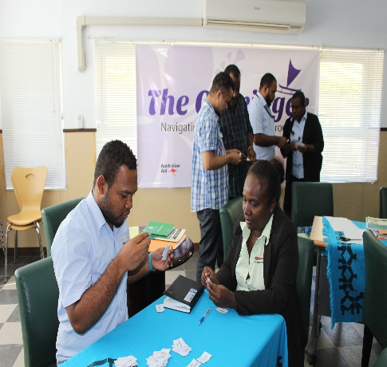
Program
The POW took take place on Wednesday 19th and Thursday 20th July 2017 at the Paul Tovua Complex.

Slide 6
Closing Program
Official closing was conducted on Thursday 21st September 2017. At Carol Seas Resort.
Attended by the following guests:
DPM of SI – Hon Manasseh Maelanga
Deputy Speaker of NPSI – Hon David Pacha
Acting Australia High Commissioner –
Ms Fiona Hoggart
PWPP Project Manager – Fiona Way
42 Participants.

Slide 7
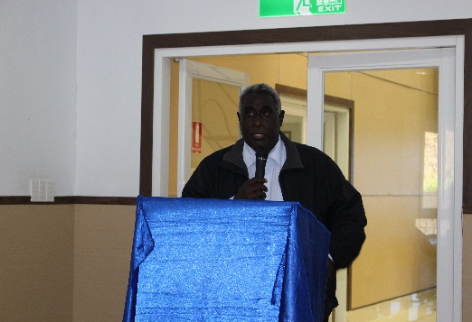
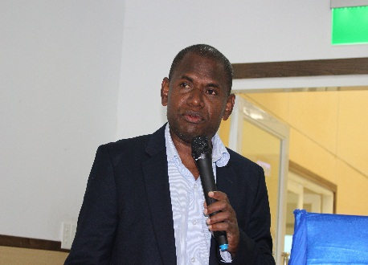
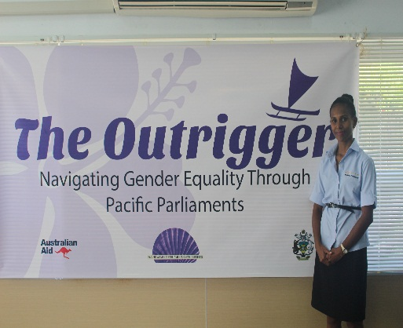
Facilitators/participants
4 National facilitators delivered the POW

Slide 8
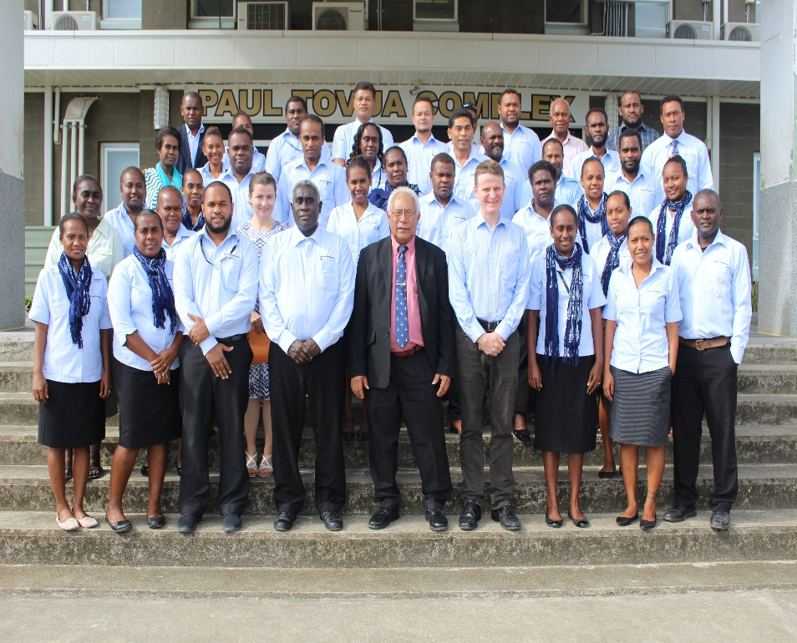
Facilitators/participants
42 Participants

Slide 9

Funding
The POW was fully supported by the Pacific Women's Parliamentary Partnership and Solomon Islands Government.

Slide 10
Recommendations
Three main recommendations:
Important to deliver the workshop in three days and not two days.
Having three days will encourage active participation by facilitators and participants.
In the future PWPP project develop course materials for public servants including officers of Parliament. The materials used at the recent workshop were designed targeting political leaders and Members of Parliament.

Slide 11
conclusion
The successful hosting of the first ever POW in SI demonstrated the strong commitment of SIG, NPSI & PWPP in ensuring gender equality is fully understand and appreciated as one of the component to stability and development in developing countries in the world in this 21st century.

