Slide 1
Where does Malcolm Turnbull sit?
The story behind establishing a Parliamentary Education Office.

Slide 2
History of the Education Office
The House of Assembly Education Office was formed in October 2015 with the appointment of an Education Officer
The Education Officer is a qualified teacher (Bachelor of Education)
The Education Officer works under the supervision of the Second-Clerk Assistant

Slide 3
Goals
The House of Assembly Education Office aims to deliver Civics and Citizenship Education to Tasmanian school students within the guidelines of the Australian National Curriculum.
It has a clear focus on the Parliament of Tasmania.
In addition, the offices aims to expand Parliamentary Education to adults within the Tasmanian community.

Slide 4
Where to start?
Reviewing what is already in place.
School groups were basically following the adult tour. Although our tour guides made every effort to modify the tour. Changes have been made to the tour and it is under constant review.
Role-plays were being trialled.
Some access to Parliament of Tasmania fact sheets.

Slide 5
Common misunderstandings

Slide 6
Common Student Misunderstandings
Where does Malcolm Turnbull sit?
Where does Andrew Wilkie sit?
The role of the President - Where does Donald Trump sit?
Does the judge sit in the big chair?
Do you send lots of people to gaol?
Does the Speaker use a wooden hammer?
Do you sit next to the other Franklin Members?

Slide 7
Common Adult Misunderstandings
Teachers:
Can we see the Senate during our visit?
Community Groups:
I don’t live in Nelson, I live in Denison.
Parent helpers:
Crossing the floor is a common occurrence and is often encouraged by a parent helper on the excursion.

Slide 8
Visitor Numbers
*Public Gallery attendance not included
A closer look at 2016 numbers:
2015 School Numbers*
1030
2016 School Numbers*
2715
2016 Number Breakdowns
Tour and Role-Play | Tour only | Role-Play only
1890 | 715 | 110
2016 School Attendance in the Public Gallery Attendance
Public Gallery only | Public Gallery and Modified Tour | Total
435 | 347 | 782

Slide 9
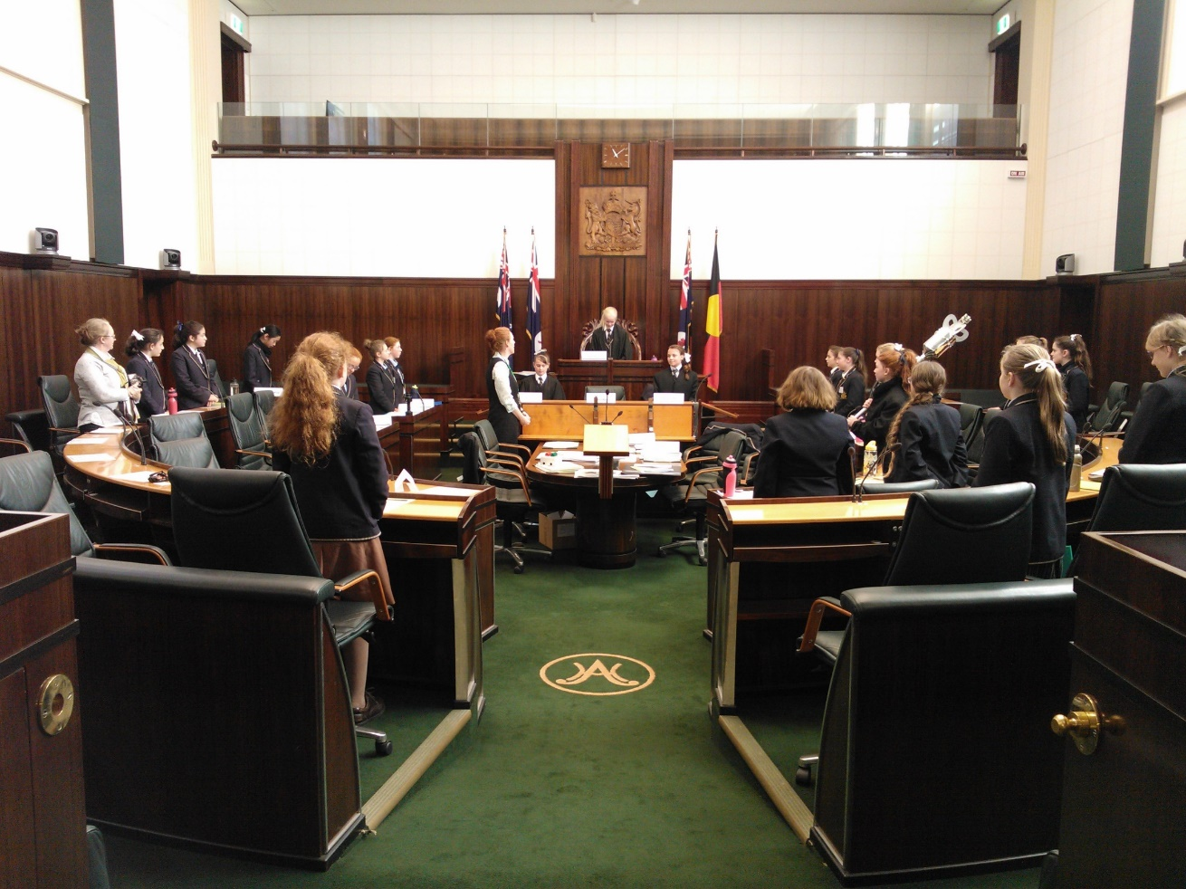
Need drives the work
School Resources
Fact sheets at different reading levels
Classroom activities to reinforce learning
Posters for classroom displays
School Outreach Programme
The draft proposal is written with a lesson plans in final planning stage. They are almost ready to ‘test run’ on classes.
Consultation with Parliamentary Staff regarding suitable state-wide venues has begun.

Slide 10
Also
Adapting the tour e.g. use of technology
New role-plays (constantly aiming to improve practice and keep the topics relevant)
COP (Community Outreach Programme)
Support for visual learners
Modified programmes for students of all abilities

Slide 11
Examples
Visual Supports
Modified Programmes
Sashes
Title cards
Treasure Hunt cards
History timeline sort
Students with a learning disability
Young students (e.g. Grade 3)
Children’s University
Stepping Up

Slide 12
Feedback
All teachers have the opportunity to provide anonymous written feedback
Very positive in both written and verbal communications
Any constructive feedback has been considered. Indeed the Treasure Hunt Cards were inspired by a teacher’s feedback
Afternoon timeslots are a challenge for schools
Chatting to teachers often gives inspiration (e.g. Meet A Clerk for Legal Studies 3)
Teachers are very positive about meeting Members of Parliament

Slide 13
Expansion of the Office
Following a successful 2017 – 2018 budget submission to the Department of Treasury and Finance, the Education Office will expand to two Education Officers

Slide 14
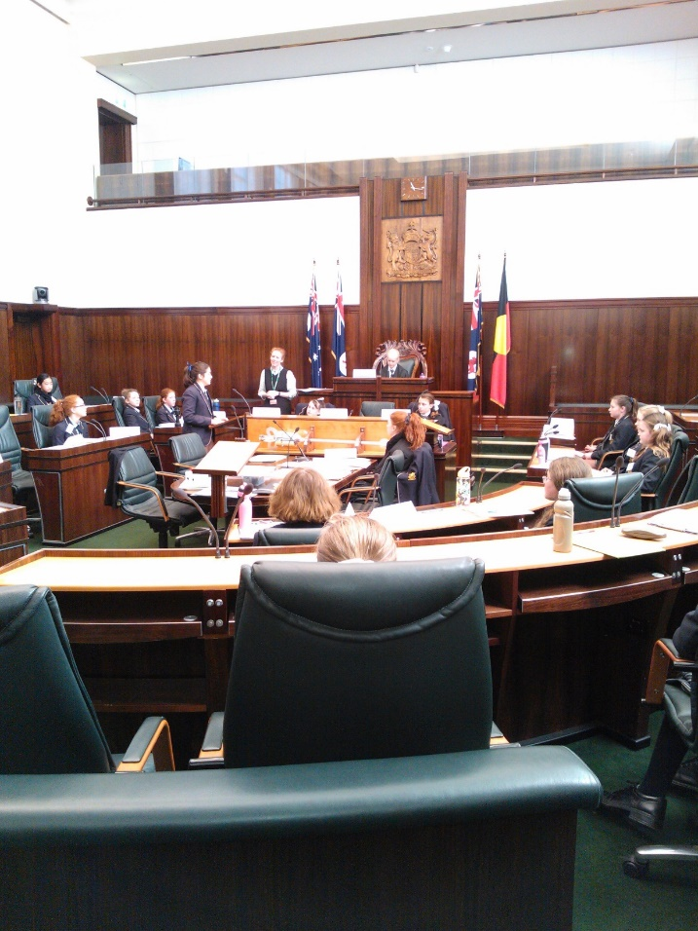
Looking forward
Specialist Legal Studies Programme – Committees
iPad usage – connecting with the digital generation
School Outreach Programme – Mobile Parliament
Specialist Tour options – e.g. History, Women in Parliament, People in Parliament, Architecture or Art Tours
Special Events – Commonwealth Day, School Leaders, Writing Competitions, Stepping Up Event
Classroom Posters
Educational Videos

Slide 15
Successes and Challenges
Great responses from teacher and students
Adapted programme for special groups (e.g. students with disabilities)
Return customers
Willingness to run special events
Establishing multiple projects in a very small team
Engaging the digital generation
Hosting large groups on sitting days
Building the Outreach Programme

Slide 16
Questions without Notice

